Slide 1
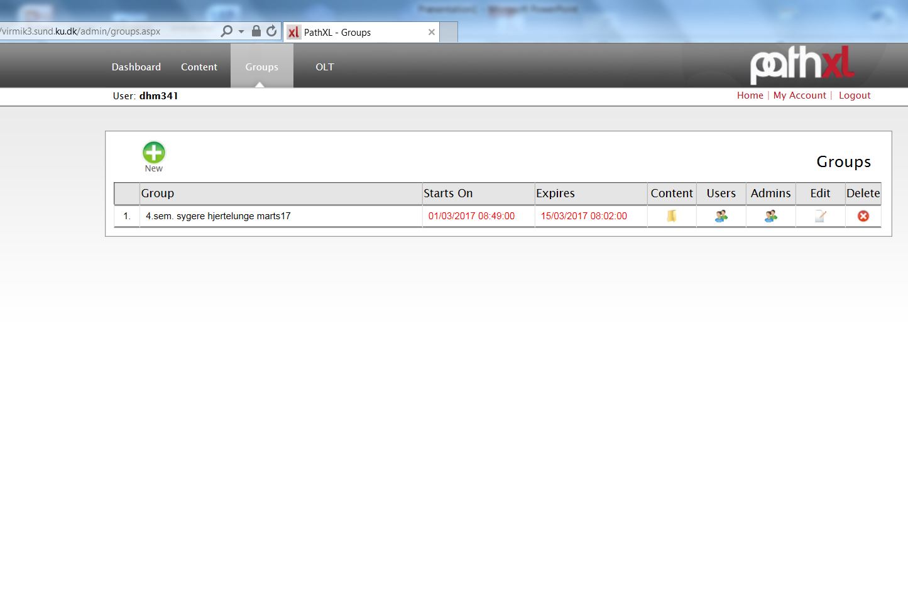
How to introduce an extra administrator in groups:
I log in and go into groups
Press admins

Slide 2
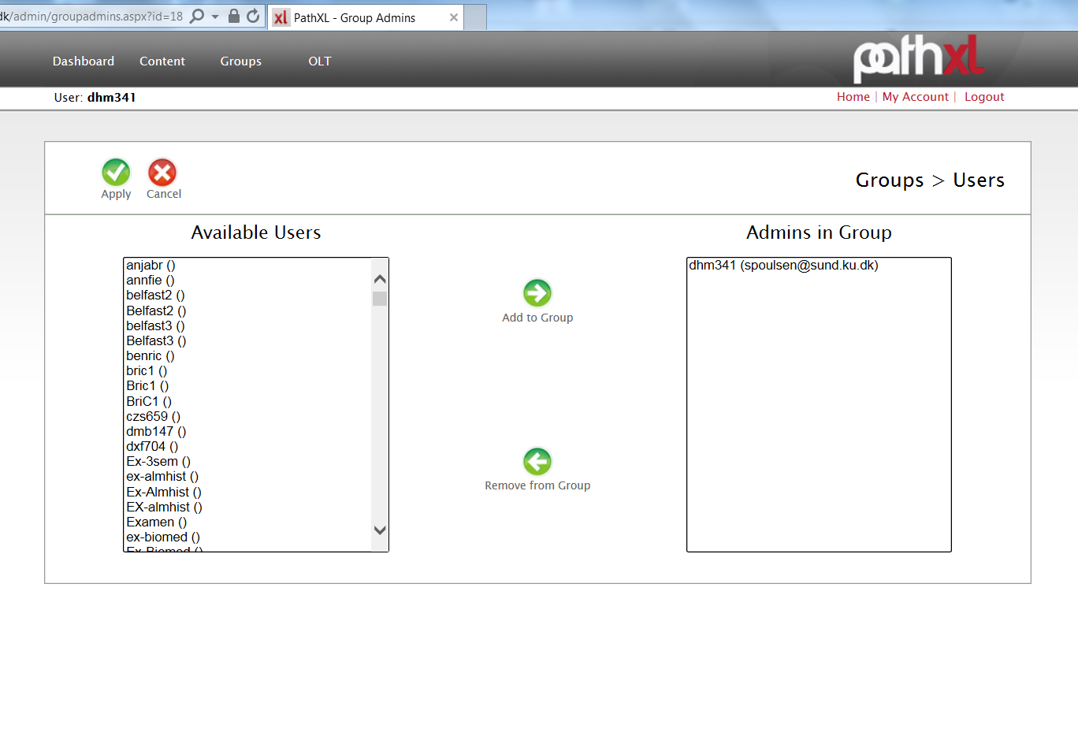
Available users
Slide owners should be here?
I find Cathrine. – the swedish number

Slide 3
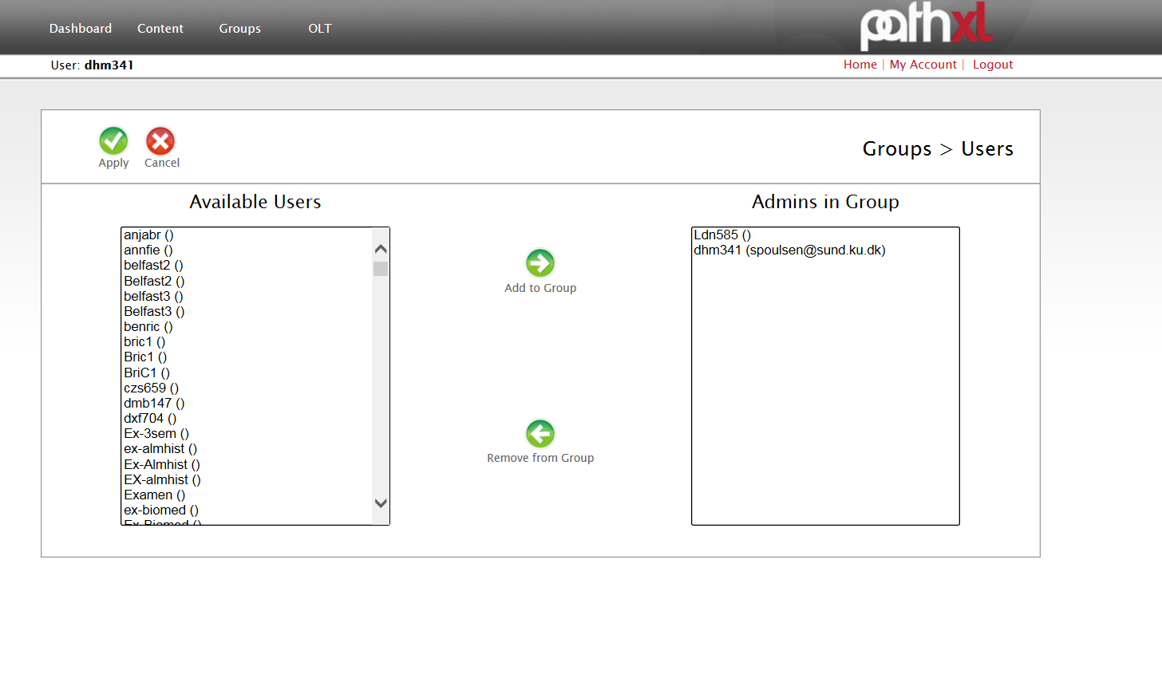
And add her to the group
And it works so no problem

